Slide 1
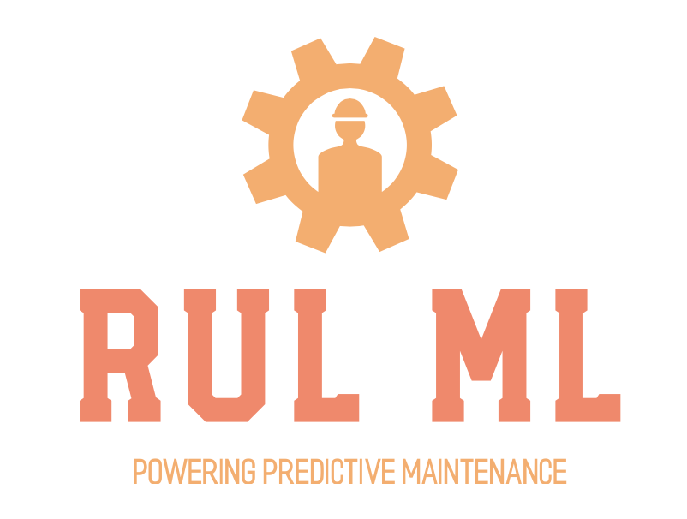
ONE PAGE NARRATIVE
The U.S. DoD’s Joint Artificial Intelligence Center has designated Predictive Maintenance as one of its two founding National Mission Initiatives (NMIs).
Better predictive maintenance can have significant impacts across the dod’s scope of responsibilities including engineering, supply chain, finance and most importantly field operations.
RUL ML™ will serve as a core engineering tool allowing maintenance teams better predictability at scale of the remaining useful life of turbofan engines. The tool allows engineering teams to:
explore relationships across engines and sensors,
upload sensor readings for rul predictions at scale
simulate the impact on rul from varying specific sensor inputs
RETrain the underlying model to re-optimize hyperparameters and feature inputs if the model drifts

